Slide 1

CCNA Exploration Semester 3
Chapter 6
Thanks to the instructors at St. Clair College in Windsor, Ontario.

Slide 2
Topics
Routing network traffic between VLANs
Configuring a router for routing between VLANs
Troubleshoot inter-VLAN connectivity issues

Slide 3
Semester 3
LAN Design
Basic Switch Concepts
Wireless
STP
VLANs
VTP
Inter-VLAN routing

Slide 4
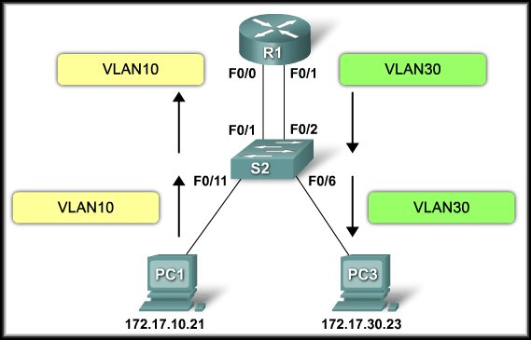
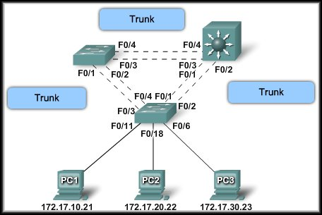
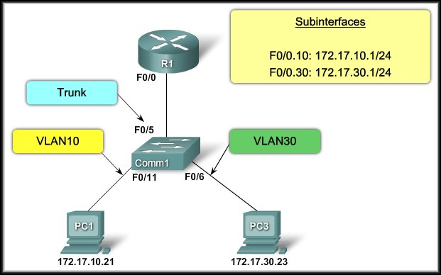
Inter-VLAN Routing
Introducing Inter-VLAN Routing

Slide 5
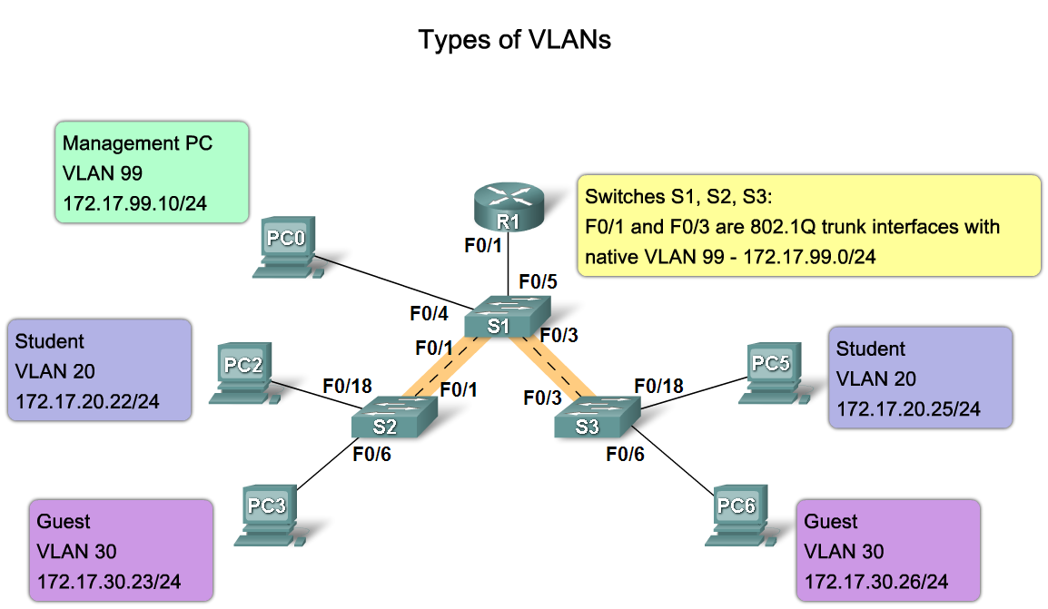
Inter-VLAN Routing
Each VLAN is a unique broadcast domain.
  Computers on separate VLANs are, by default, not able to communicate.
Each VLAN is a unique IP subnetwork.

Slide 6
Inter-VLAN Routing
To allow different VLANs to communicate:
We need a router to communicate among separate broadcast domains and unique IP subnetworks.
Inter-VLAN routing, then, is a process of forwarding traffic from one VLAN to another VLAN using a router.

Slide 7
Inter-VLAN Routing- Types
Traditional Inter-VLAN Routing.
Router-on-a-stick Inter-VLAN Routing.
Switch Based Inter-VLAN Routing.

Slide 8
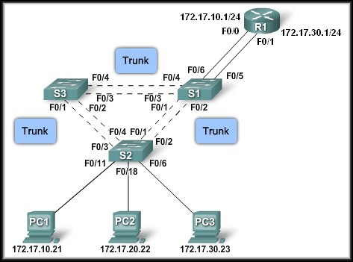

Traditional Inter-VLAN Routing
Internally Routed to the proper subnet.
One router interface per VLAN.
VLAN Tagged
Tag
removed

Slide 9
Traditional Inter-VLAN Routing
Routers must have multiple physical interfaces to facilitate inter-VLAN routing.
Each interface is also configured with an IP address for the subnet associated with the particular VLAN that it is connected to.
Each router interface acts as default gateway for the devices connected to that VLAN.

Slide 10


Traditional Inter-VLAN Routing
Router tags
the frame
for VLAN 30
And switches it
to Port F0/1.
Router Responds
Routing table:
172.17.10.0 – F0/0
172.17.30.0 – F0/1
No ARP for PC3 ???
Packet send from VLAN10 to VLAN30
Tagged
VLAN 10
Tagged
VLAN 30
Tag
Removed
ARP for ???

Slide 11
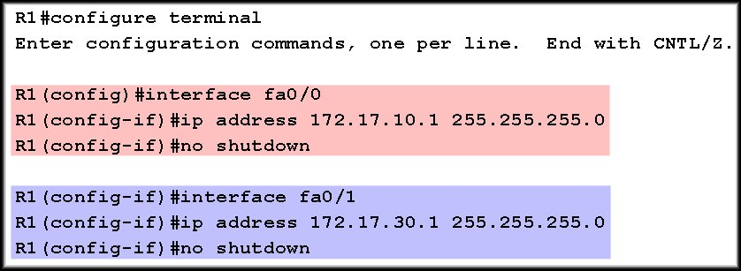
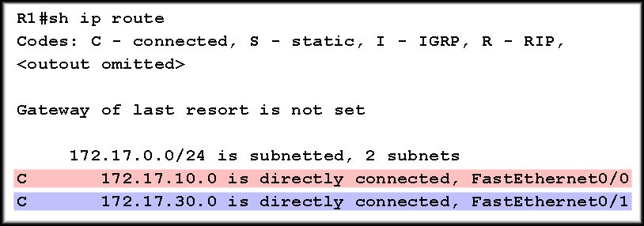
Traditional Inter-VLAN Routing

Slide 12
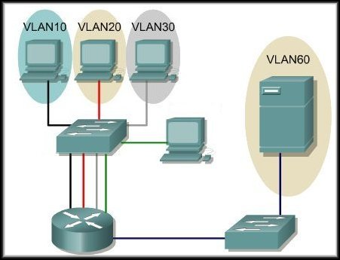
Traditional Inter-VLAN Routing
Routers have a limited number of physical interfaces that they can use to connect to different VLANs.
It is very expensive to add an Ethernet Interface.

Slide 13
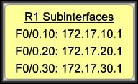
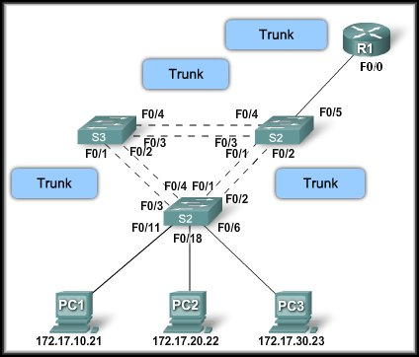
Router –on-a stick
One router interface for all VLANs.
Internally Routed to the proper subnet.
VLAN Tagged
Tag
removed
Packet send from VLAN10 to VLAN30

Slide 14
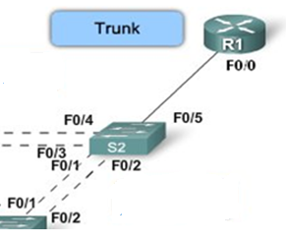
Router –on-a stick
Subinterfaces:
  Software-based virtual interfaces that are assigned to physical interfaces.
  Each subinterface is configured with its own IP address, subnet mask, and unique VLAN assignment.
  Connected to a switch trunk link.
  Overcomes the hardware limitation of a router.
  Functionally the same as using the traditional routing model.

Slide 15
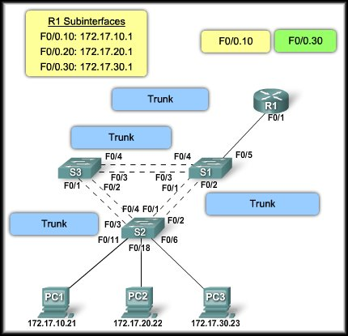
Router –on-a stick
Routing table:
172.17.10.0 – F0/0.10
172.17.30.0 – F0/0.30
Tagged
VLAN 30
Tagged
VLAN 10
Tag
Removed
Tag
Removed
Tagged
VLAN 30
Tag
Removed

Slide 16
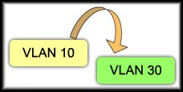
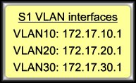
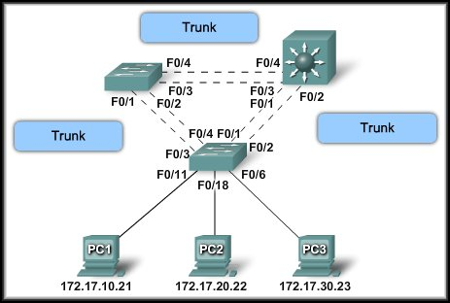
Layer 3 Switches
Uses Switch Virtual Interfaces (SVI) to retag
the frame.
Tag
removed
VLAN Tagged
(10)

Slide 17


Slide 18
Router –on-a stick
Configuring Subinterfaces:
    Create the subinterface.
    Assign it to a VLAN.
    Assign an IP Address.
    Enable the interface.

Slide 19
Router –on-a stick
Create the subinterface:
R1(config)#interface [interface].nn
physical interface number
A subinterface number, it is typically associated to reflect the VLAN number.
NOTE: The management VLAN must also be configured if you wish to use it on multiple switches that are not directly connected by trunk links.

Slide 20
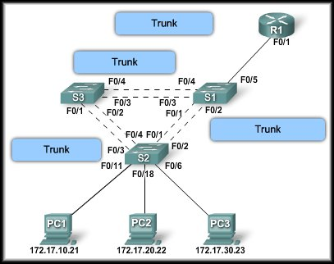

Creating Sub interfaces
VLAN10
VLAN30

Slide 21
Assign it to a VLAN
Before assigning an IP Address, the interface must to be configured to operate on a specific VLAN using the proper trunking encapsulation.
R1(config-subif)#encapsulation dot1q vlan-id
IEEE802.1q Trunking encapsulation.
VLAN number

Slide 22
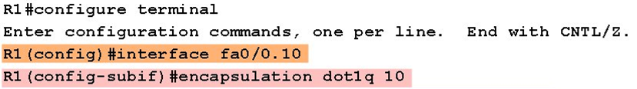
Assigning it to a VLAN
VLAN10
VLAN30

Slide 23
Assign an IP address and enable it.
Assign an IP Address:
  The IP Address assigned here will become the default gateway for that VLAN.
R1(config-subif)#ip address [address] [mask]
Enable the Interface:
  Subinterfaces are not enabled individually.
  When the physical interface is enabled, all associated subinterfaces are enabled.
R1(config-if)#no shutdown

Slide 24
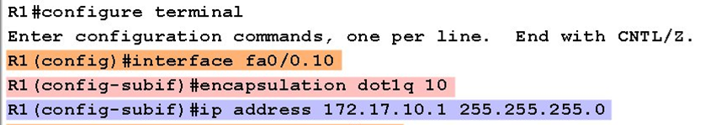
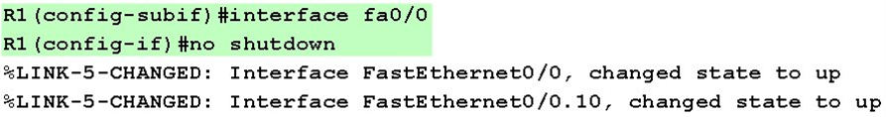
Assigning it to a VLAN
VLAN10
VLAN30

Slide 25
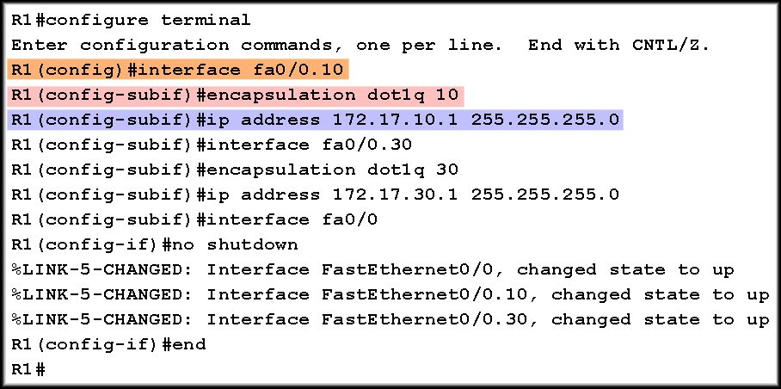
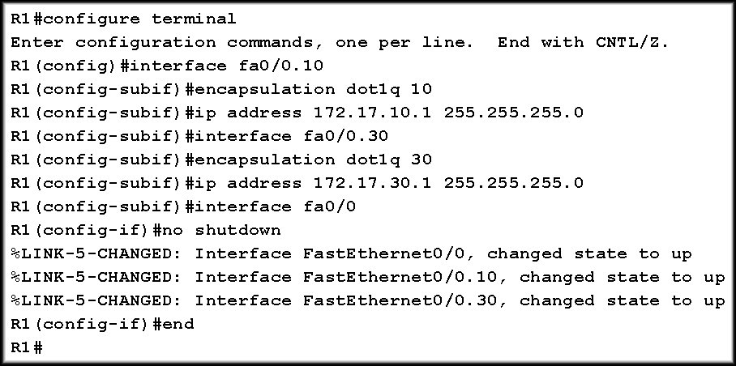
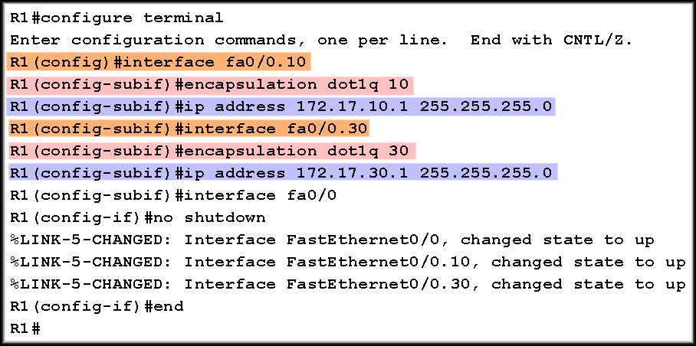
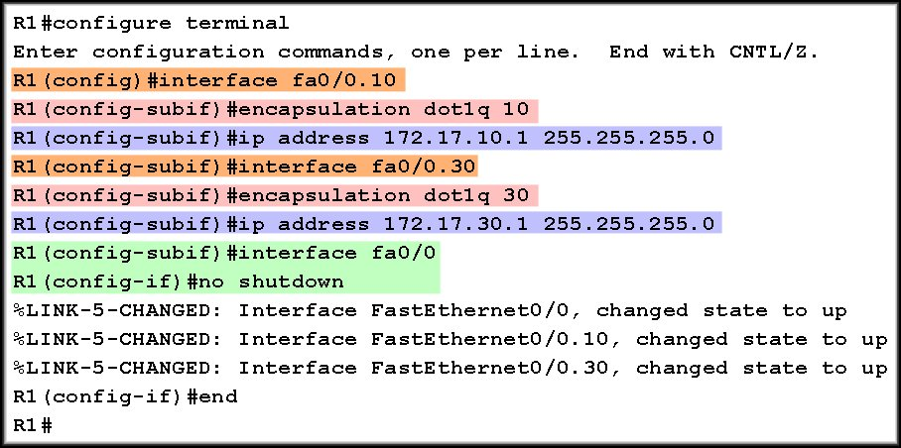
Inter VLAN- Router on a Stick
Configuring Subinterfaces:
VLAN 10
VLAN 10
VLAN 10
VLAN 30
VLAN 30
Enable Interfaces

Slide 26
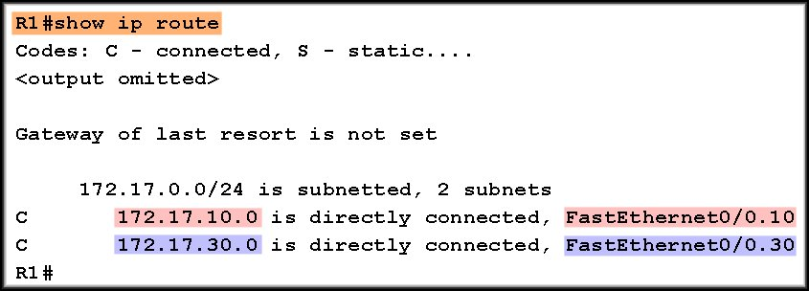
Inter VLAN- Router on a Stick
Planning:
Planning!

Slide 27
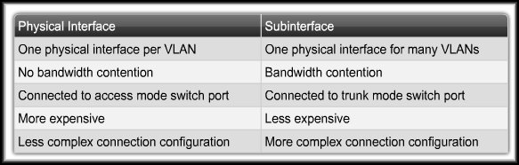
Comparison
Router Interface and Subinterface Comparison:

Slide 28
(Putting It All Together)

Slide 29
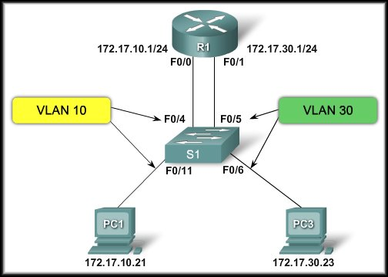
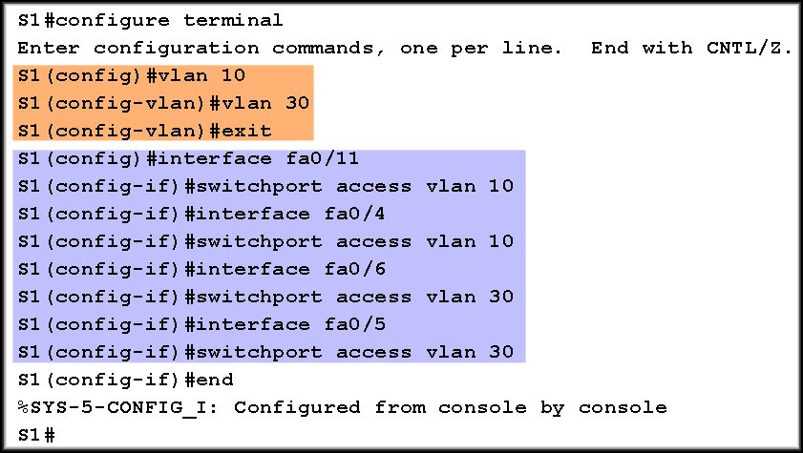
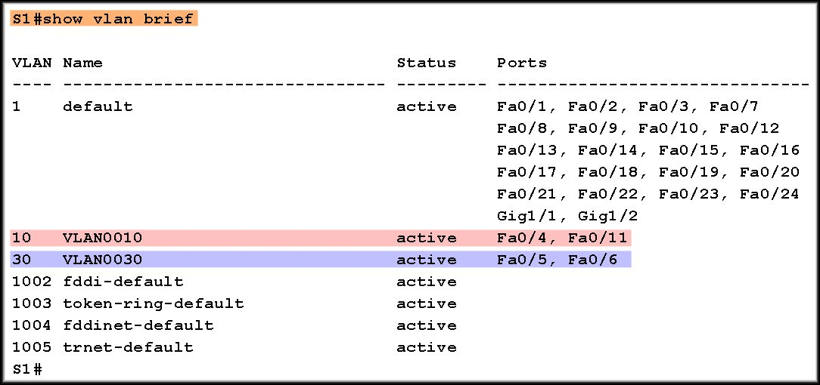
Traditional Inter VLAN- Routing
Switch Configuration:

Slide 30
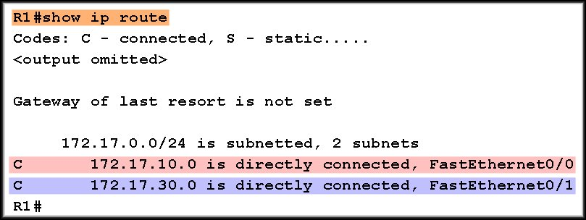
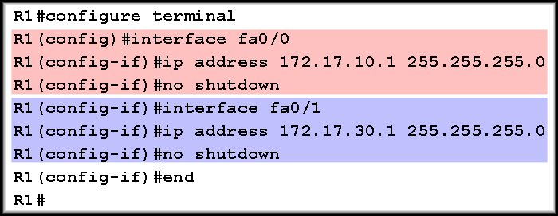
Traditional Inter VLAN- Routing
Router Configuration:

Slide 31
Traditional Inter VLAN- Routing
Traditional Inter-VLAN Routing:

Slide 32
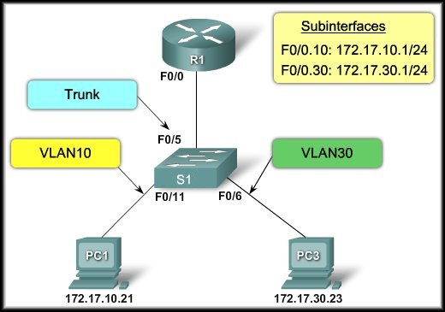
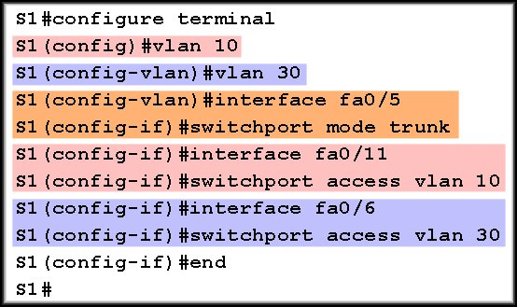
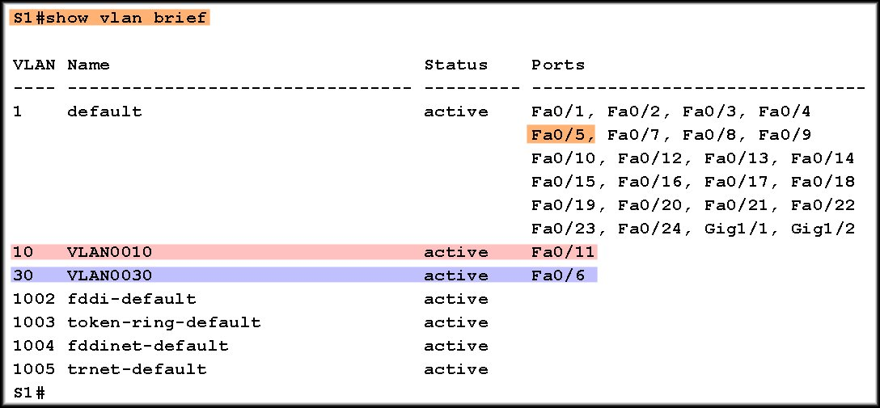
Router on a Stick
Switch Configuration:
VLANs
Trunk in Native VLAN
Trunk
Interfaces
VLANs

Slide 33
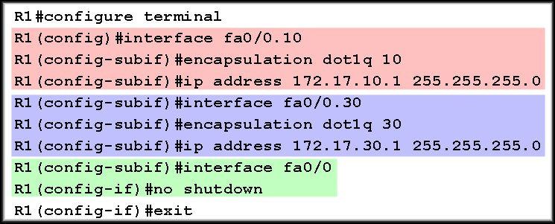
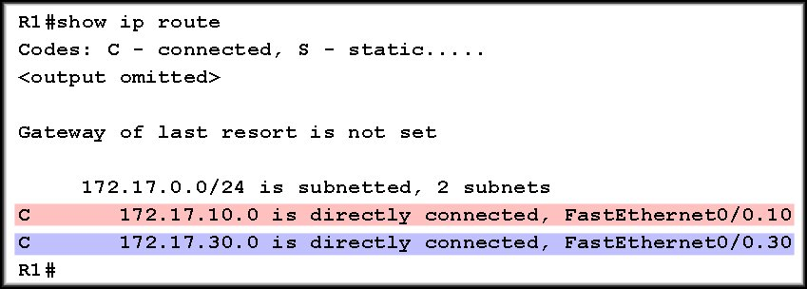
Traditional Inter VLAN- Routing
Router configuration:
VLAN 10
VLAN 30
Enable All Subinterfaces

Slide 34


Slide 35
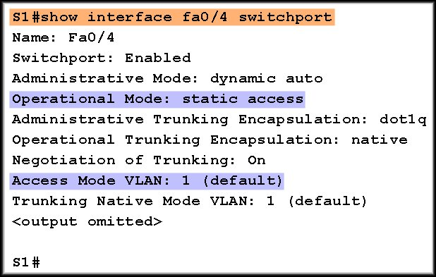
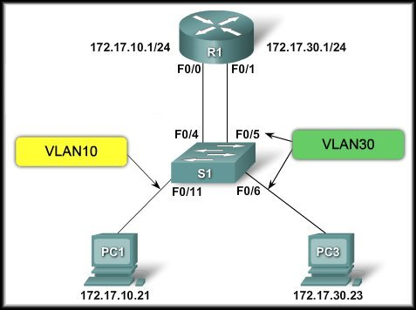
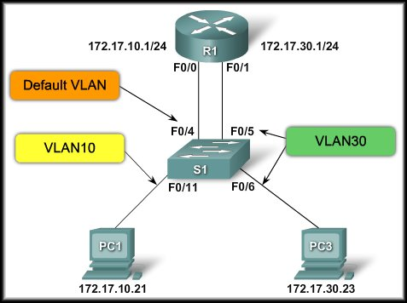
Traditional Inter-VLAN Routing
VLAN 30 is working but VLAN 10 cannot communicate with the router or VLAN 30.
Switch Configuration Issues:
Interface F0/4 is still in the default VLAN.
interface fa0/4
switchport access vlan 10

Slide 36
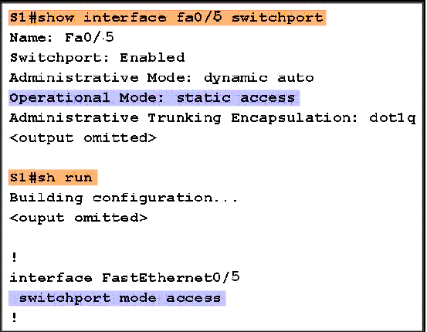
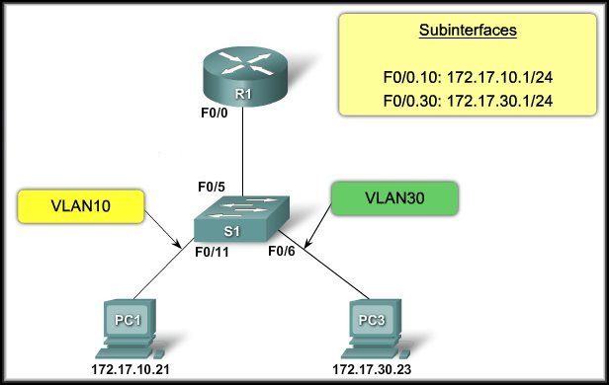
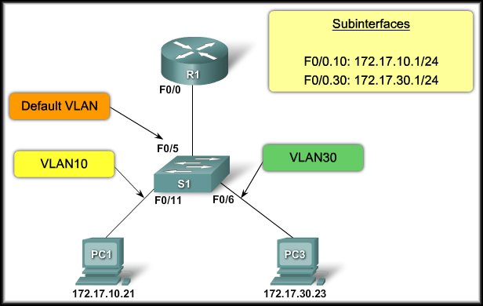
Inter-VLAN Routing
Each of the configured subinterfaces is unable to send or receive VLAN traffic.
Switch Configuration Issues:
Interface F0/5 is still in the default VLAN.
interface fa 0/5
switchport mode trunk

Slide 37
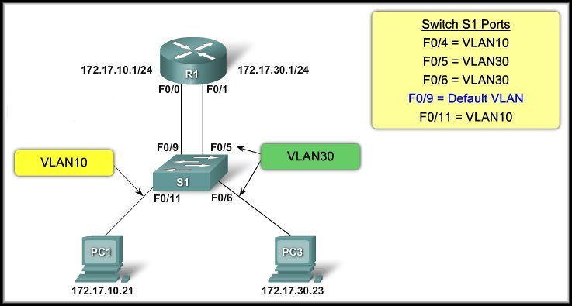
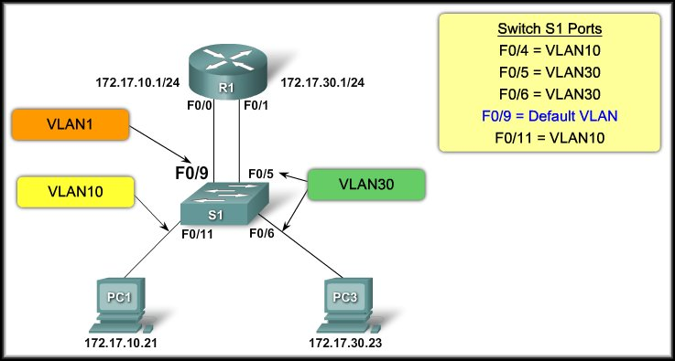

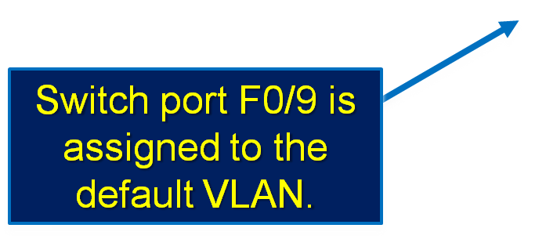
Traditional Inter-VLAN Routing
PC1 cannot communicate with the router interface and the router cannot route to VLAN 30.
Router Configuration Issues:
Switch port F0/4 is for VLAN 10.
Move the cable from F0/9 to F0/4.
Move the cable from F0/9 to F0/4.
One of the most common mistakes in Inter-VLAN routing.

Slide 38
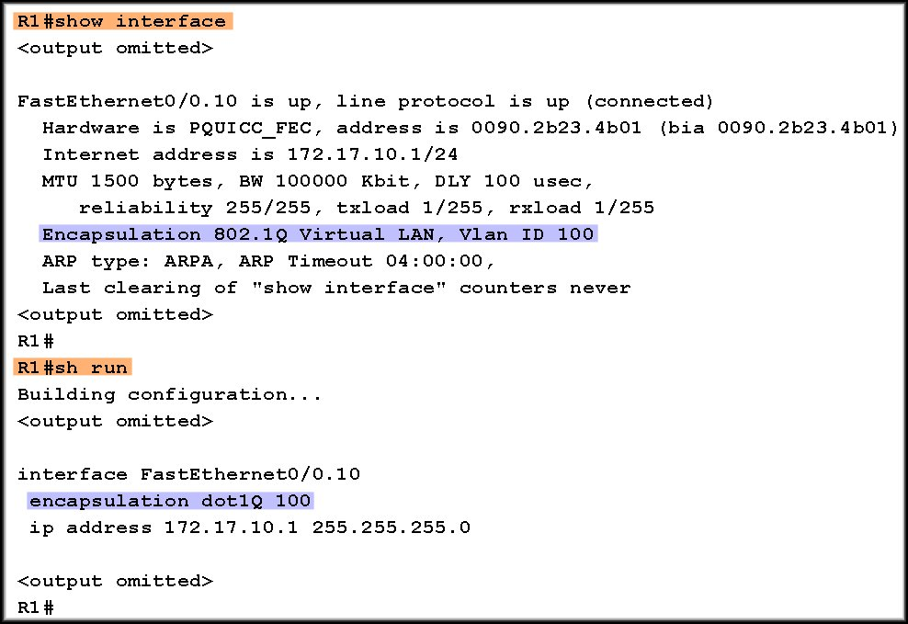
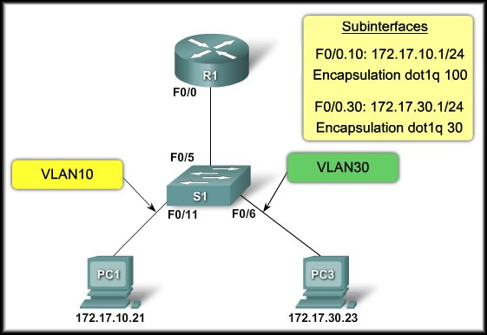

Inter-VLAN Routing
PC1 cannot communicate with the router interface and the router cannot route to VLAN 30.
Router Configuration Issues:

Slide 39
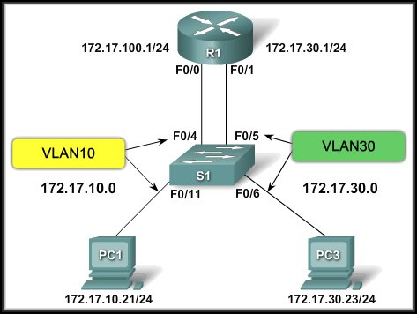


Traditional Inter-VLAN Routing
IP Addressing Issues:
PC1 cannot communicate.
Incorrect IP address for subnet 172.16.10.0/24.
Incorrect IP address for subnet 172.16.10.0/24.
Incorrect subnet mask for subnet 172.16.10.0/24.

